Slide 1
Bacchus Winery Case Study
Team Indigo || Jacob Ives, Josh Aguilar, Jeff Pederson, Sam Crandall, Kadar Gayle

Slide 2
AGENDA
Group Introduction
Case Study Description
Finalized ERD
Descriptions of Reports
Examples of Report Results

Slide 3
Group INTRODUCTION
Team Indigo is made up of Jacob Ives, Josh Aguilar, Jeff Pedersen, Sam Crandall, and Kadar Gayle. We have collaborated to find a solution to the Bacchus Wine case study by implementing a divide and conquer method throughout this project, breaking up the work into two main roles; coding and documenting.

Slide 4
Description of Case Study
Bacchus Winery is a small-scale producer of grapes needed to make a Merlot, Cabernet, Chablis, and Chardonnay. Like many other inherited businesses, the new owners are beginning the process of streamlining their existing data and operations. Three of the main points the company would like to address are listed below:
- Are all suppliers delivering on time? Is there a large gap between expected delivery and actual delivery? A month by month report should show problem areas.
- Are all wines selling as they thought? Is one wine not selling? Which distributor carries which wine?
- During the last four quarters, how many hours did each employee work?
The team's overall goal is to be able to manage key performance indicators more efficiently and we believe they can do that by using a database that houses information related to employees, employee pay, inventory, items, outbound orders, inbound orders, distributors, and suppliers.

Slide 5
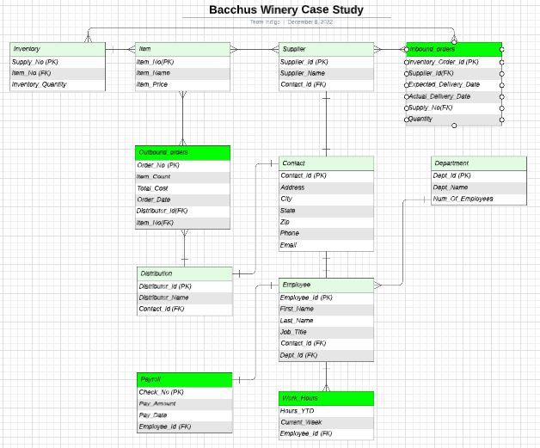
Finalized ERD

Slide 6
Sales Reports
Our first three reports were created to provide solutions for the following questions:
Are all wines selling as they thought?
Is one wine not selling?
Which distributor carries which wine?
Our first report titled, "Distributor_Report.py", was created to address question number three above. It finds and groups the types of wines sold associated with each distributor.
Our second report titled, "Monthly_Sales_Report.py", was created to address question number one above. It finds and groups the total sum of items sold, grouped by year and month.
Our third report titled, "Wine_Sales_Report.py" was created to address question number two above. It finds and groups the total number of wines sold, year-to-date, by type.

Slide 7
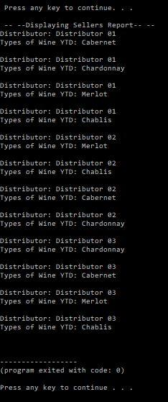
Distributor Sales Report

Slide 8
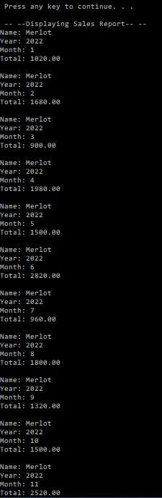
Monthly Sales Report

Slide 9
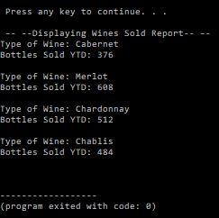
Wine Sales Report

Slide 10
Delivery Report
Our next report was created to provide a solution for the following two questions:
Are all suppliers delivering on time?
Is there a large gap between expected delivery and actual delivery?
Our report titled, "Delivery_Arrival_Report.py", is written with the purpose of tracking inbound deliveries by month to ensure they are being delivered on time by comparing their expected delivery date to their actual delivery date.

Slide 11
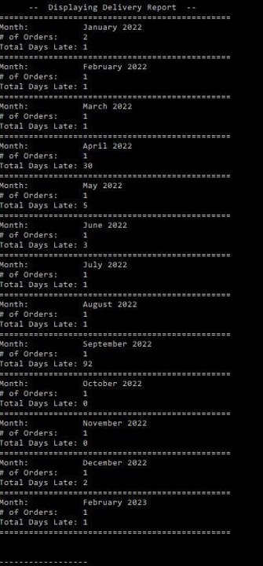
Delivery Report

Slide 12
EMPLOYEE HOURS REPORT
Our final report was created to provide a solution to the following question:
During the last four quarters, how many hours did each employee work?
Our report titled, "Bacchus_Winery_Hours_Report.py", is written with the purpose of showing a workers hours broken down by the current week as well as the current hours worked, year to date.

Slide 13
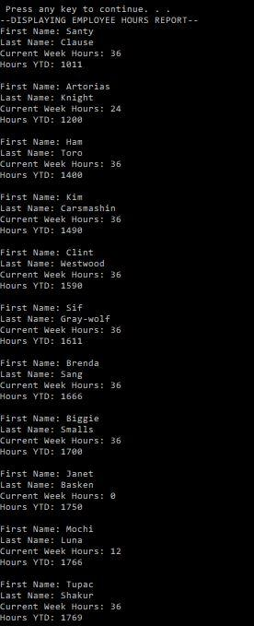
Employee Hours Report

Slide 14
THANK YOU

